Slide 1
Debunking Microservices
Tech Buzz Episode # 2
Parth Ghiya parth.ghiya@knowarth.com

Slide 2

About Me
Associate Senior Consultant and Practice Lead of Labs And Research / Full Stack Practice @ KNOWARTH
Technocrat / Developer / Trainer / Author / Reviewer / Traveler And an immense Foodie… ;)
Author of Typescript Microservices
Reviewed Books : Building Web Apps with Spring 5 and Angular 4 and Hands-On TypeScript for C# and .NET Core Developers
Facebook: ghiya.parth
Twitter: parthghiya

Slide 3
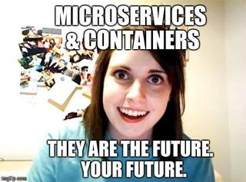
Agenda
RESTful services
Rise of microservices
Monolithic Vs Microservices
FAQ’s of Microservices
Microservices Core Components
Microservices Design Patterns
Microservices Advantages
Example Implementation
Design Patterns
Notes:
ECMA abbreviated form of European Computer Manufacturers Association

Slide 4
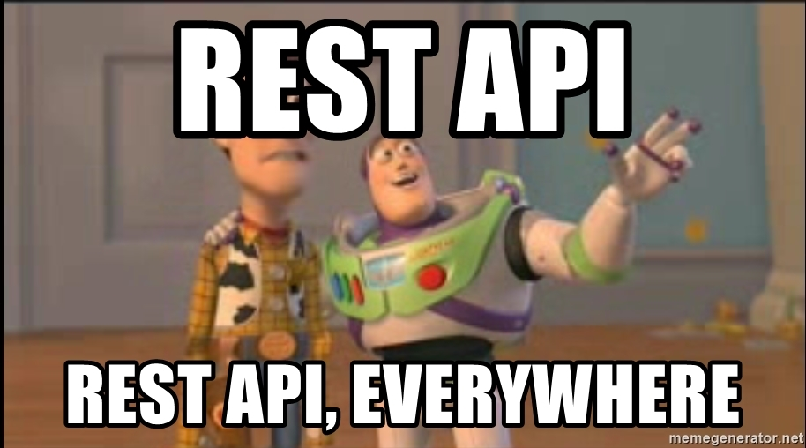
Introduction to RESTful API
What is REST ? Constraints !
HTTP: Rest is the Way HTTP should be used, various Methods
Stateful vs stateless
To use or not to use Session
SOAP vs REST
HATEOAS
Useful tools

Slide 5
What is REST and what is HTTP?
Representational State Transfer
Architectural Styles for Designing any networked applications
Relies on stateless, client server protocol, almost always HTTP
Treats server objects as resources that can be cached, destroyed or created
Can be used by virtually any programming Language
GET
Retrieves Data from a specified resource
POST
Submit Data to be processed to a specified resource
PUT
Updated Specified resource
DELETE
Deletes a Specified Resource
HEAD
SAME as get but does not returns a body
OPTIONS
Returns supported HTTP Methods
PATCH
Update Partial Resources

Slide 6
REST Constraints
Client Server
Client Server can evolve separately without any dependency on each other as long as the interface between them is not altered.
Stateless
No client context shall be stored on the server between requests. The client is solely responsible for managing state of application : No session, No history
Cache
Well managed caching partially or completely eliminates some client server interactions, improving scalability and performance. Example: Caching Libraries, HTTP Cache

Slide 7
REST Constraints
Uniform Interface
Once a developer becomes familiar with one of your API’s he should be able to follow similar approach for Any API’s
Code On Demand
Clients may call your API to get a UI Widget rendering code. It is permitted. It is not like “you are breaking the law”.
Layered System
You deploy your API’s on server A, store data on server B, Authenticate requests in server C, doesn’t matter as long as it is REST.

Slide 8
HATEOAS –Hypermedia As The Engine Of Application State
Latest Constraint of REST application architecture.
Hypertext should be used to find your way through the API and not anything else.
GET /account/12345 HTTP/1.1
HTTP/1.1 200 OK
<?xml version="1.0"?>
<account>
<account_number>12345</account_number>
<balance currency="usd">100.00</balance>
<link rel="deposit" href="/account/12345/deposit" />
<link rel="withdraw" href="/account/12345/withdraw" />
<link rel="transfer" href="/account/12345/transfer" />
<link rel="close" href="/account/12345/close" />
</account>

Slide 9
HATEOAS
GET /account/12345 HTTP/1.1
HTTP/1.1 200 OK
<?xml version="1.0"?>
<account>
<account_number>12345</account_number>
<balance currency="usd">-25.00</balance>
<link rel="deposit" href="/account/12345/deposit" />
</account>

Slide 10
Useful Tools And Meaningful Terminologies
Error Codes
200+ means the request has succeeded.
300+ means the request is redirected to another URL
400+ means an error that originates from the client has occurred
500+ means an error that originates from the server has occurred
Swagger
Authentication – JWT
Versioning – Request Header or Directly in the API Request

Slide 11
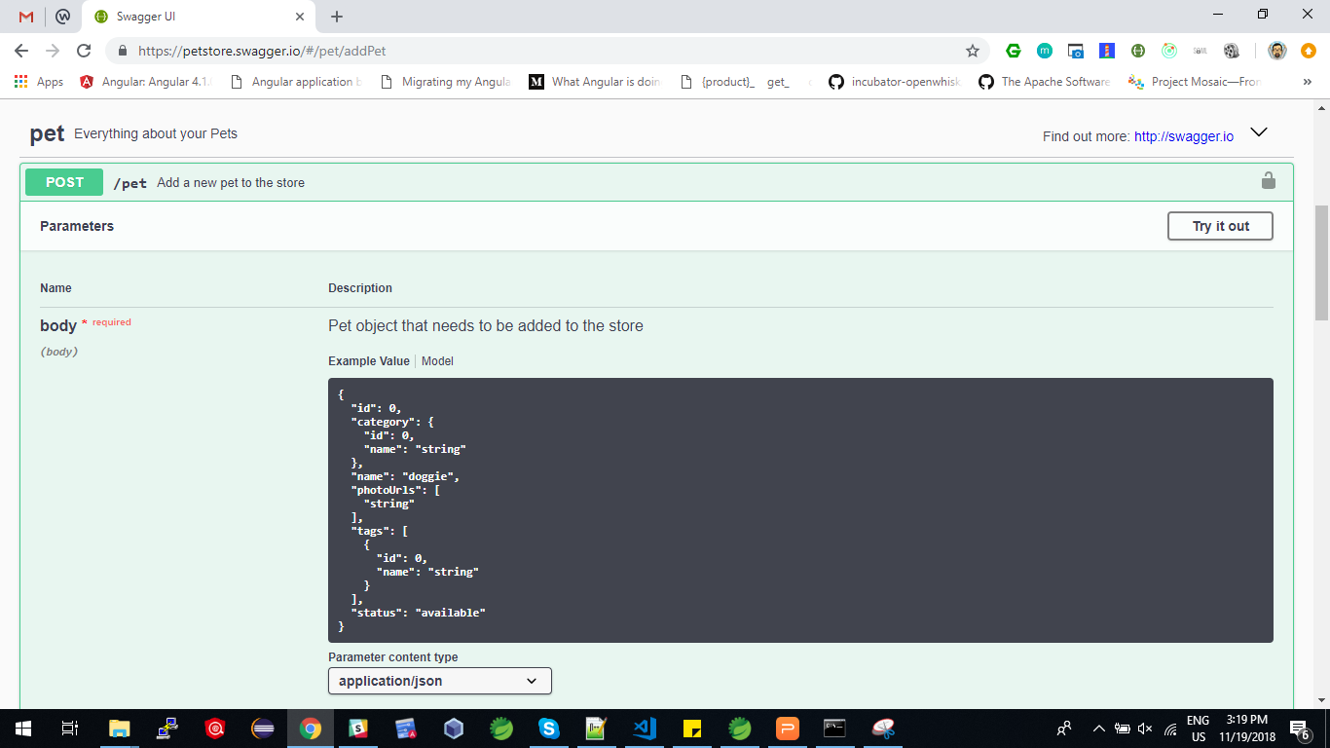
Swagger (https://petstore.swagger.io/)

Slide 12
Useful Tools And Meaningful Terminologies
Idempotent Requests
An idempotent HTTP method is an HTTP method that can be called many times without different outcomes. It would not matter if the method is called only once, or ten times over. The result should be the same. It essentially means that the result of a successfully performed request is independent of the number of times it is executed. For example, in arithmetic, adding zero to a number is idempotent operation.
POST is NOT idempotent.
GET, PUT, DELETE, HEAD, OPTIONS and TRACE are idempotent.

Slide 13
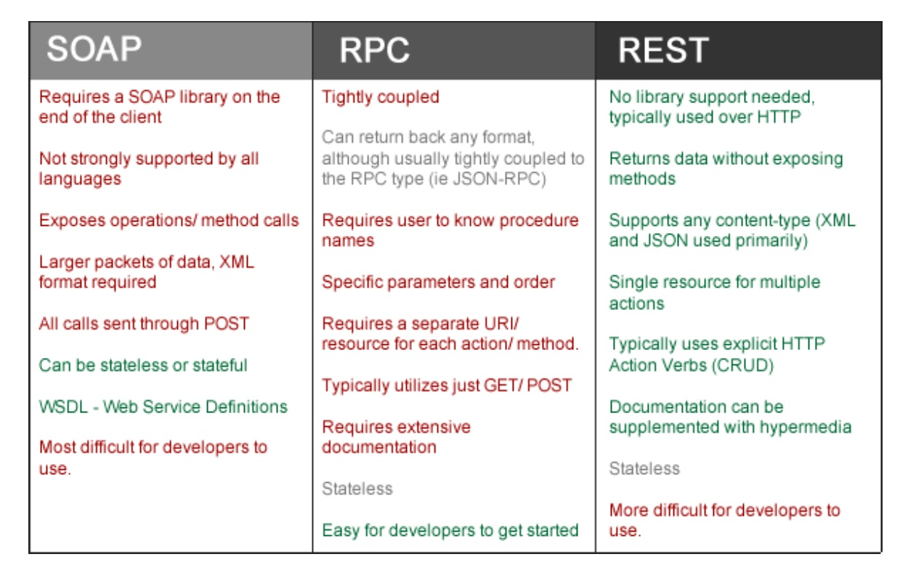
REST vs SOAP vs RPC

Slide 14
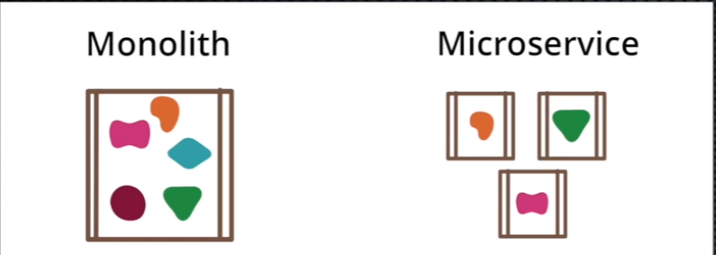
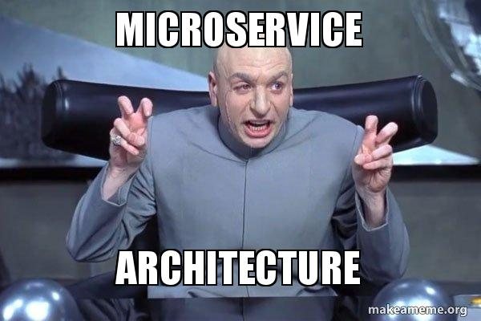
Introduction to Microservices
“If I had asked people what they wanted, they would have said faster Horses”
– Henry Ford

Slide 15
So What is a Microservice ?
An architectural style to structure an Application as a small collection of small autonomous services involving around a business domain.
Each service is self contained and it always implements a single business capability.
Business Capability???? Any thing that suffices a single business requirement and does that well.
For example: A payment microservice - It fullfills payment requirement, well and does not care wheather the inventory is managed or not. It just communicates with Inventory as and when required.

Slide 16
But wait !!!!! I already Know SOLID PRINCIPLES
SOLID Principles are great, but they are not microservices architecture.
At the end of the Day it is still a Monolithic Application and it has several challenges
Inflexible (No Combination of Different Technologies)
Unreliable (If something falls, everything falls : stack of cards)
Unscalable (Not easy to scale : Gosh how many clusters i need to scale)
Blocks Continous Development (Understanding the Entire Deployment cycle !! Phew)
Slow Development (Everything is dependent on each other, Phew Tangled Dependencies)
Not Fit for complex Applications (Just imagine applications which are used daily which need zero downtime like Netflix, Amazon, Gmail)

Slide 17
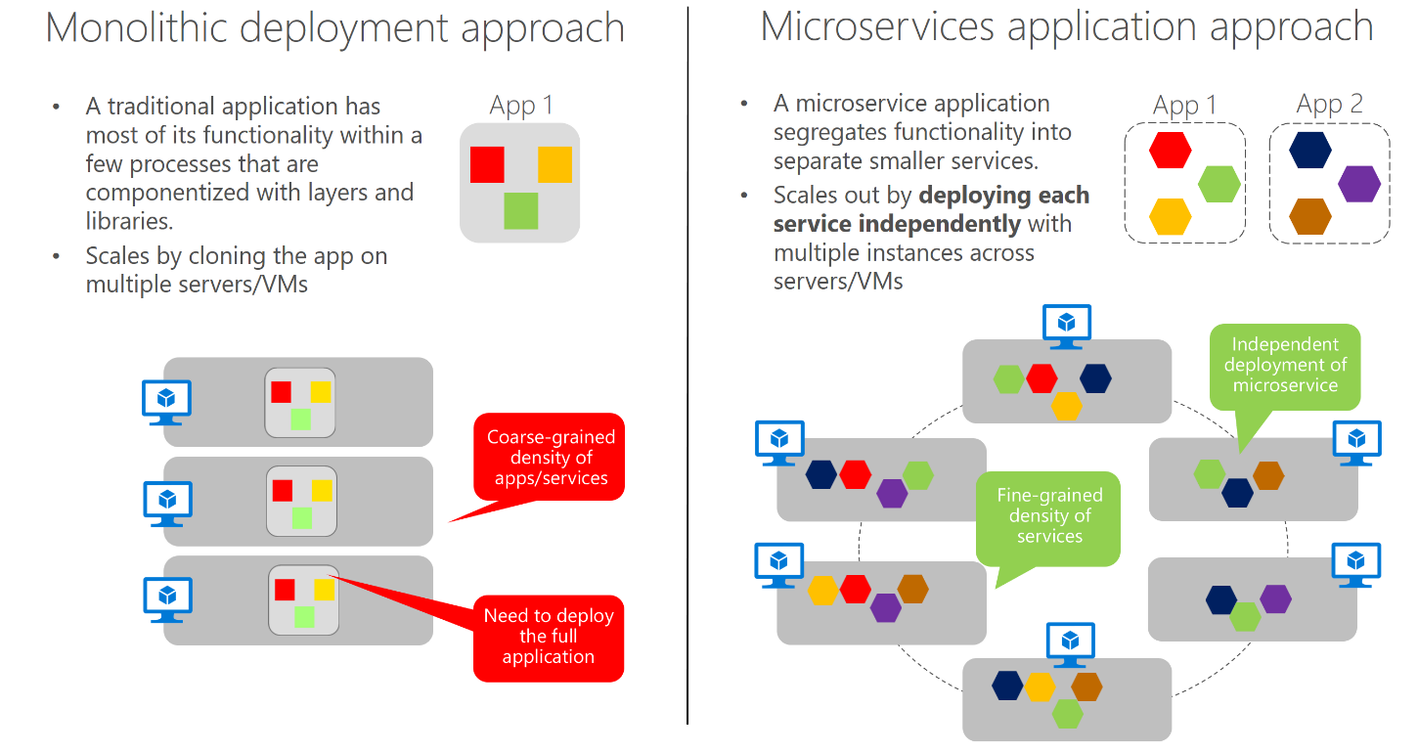
So how does this differ from Monolithic Approach ?

Slide 18
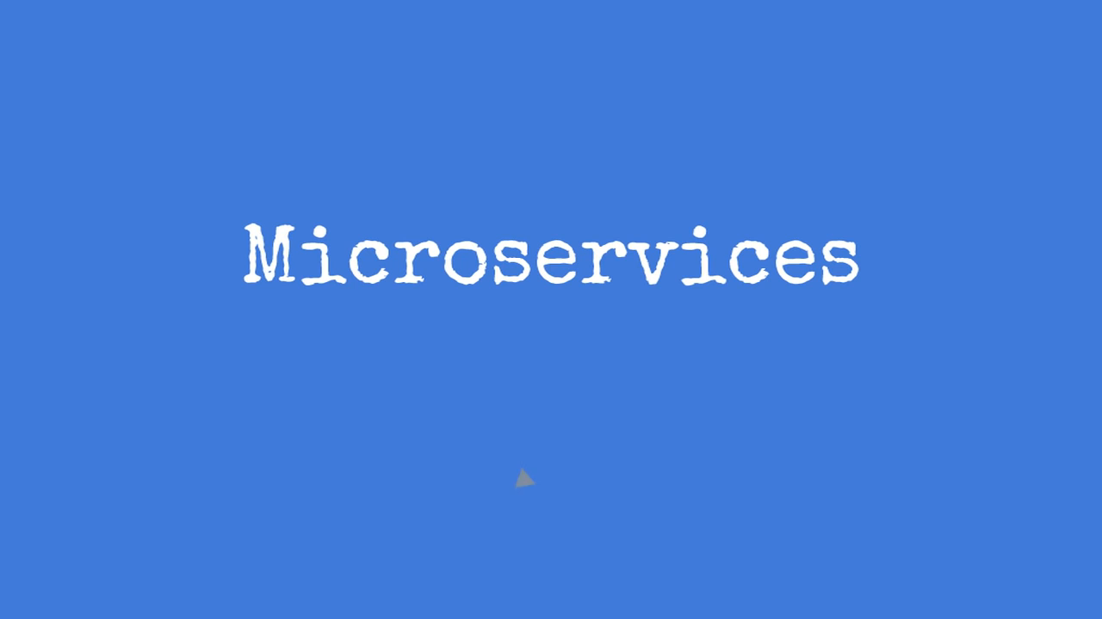
Microservices FAQ’s

Slide 19
Microservices FAQ's
Aren't microservices just like service oriented architecture (SOA) ? Don't I Already have them ? When should i start ?
How we deal with all the parts? Who's in charge ?
How do i begin with microservice development ?
What kind of tools and technologies are required ?
How do i govern a microservices system ?
Should all Microservices be coded in same language ?

Slide 20
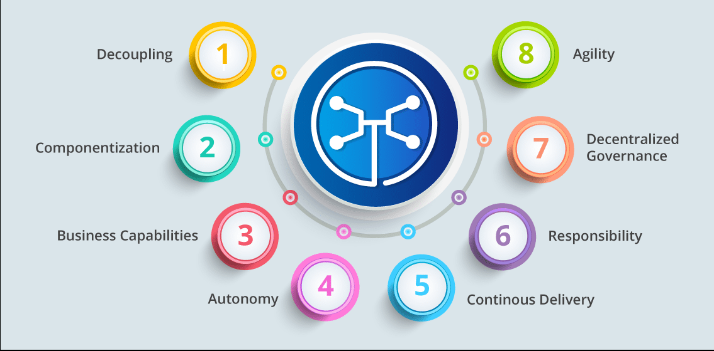
Microservice's Characteristics

Slide 21
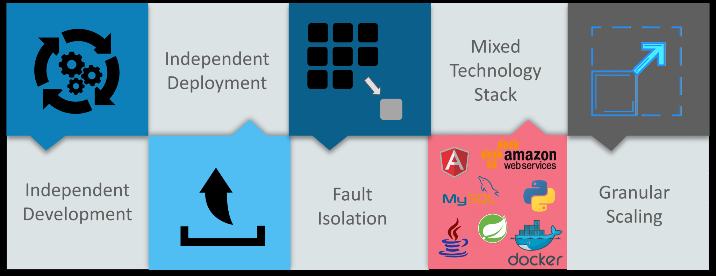
Microservices Advantages

Slide 22
How to design Microservices ?
Seperate Data store for each microservice
NoSQL Data
SQL Data
Cached Data
Keep Code at similar at same level of maturity
Seperate Build for each Microservice (Each service gets build seperately)
Deploy into containers (Easily Scalable)
Treat Server as stateless (Nothing to store in state, if you want to cache data use Cache Databases)

Slide 23
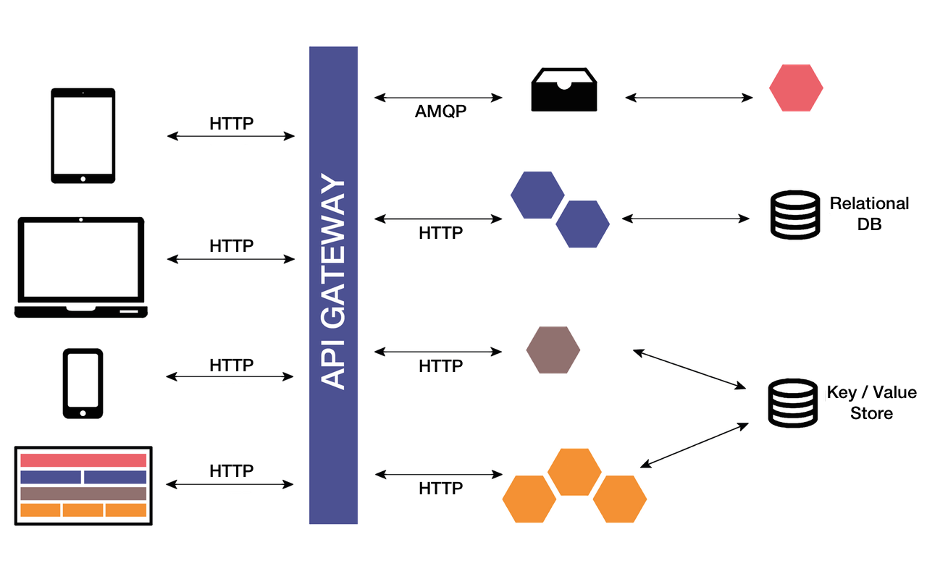
A general Microservice Architecture

Slide 24
Microservice Core Components
API Gateway - Authentication, Authorization,Security, Rate Limits etc.
Service Registry
Service Discovery
Circuit Breaker
Centralized Logs (ELK)
Communication Between Microservices
HTTP
Remote Procedure Invocation
Messaging and Message Bus (Kafka, ActiveMQ, RabbitMQ)
Protobufs

Slide 25
Netflix Components Available
Component | Purpose
Netflix Ribbon | A load balancer that is used by service consumers to find services at runtime.
Netflix Hystrix | A circuit breaker that is used to keep the system up and running. Hystrix breaks the connection for servers that are going to fail.
Netflix Eureka | Used for service discovery and service registration. It allows services to register them at runtime.
Netflix Turbine | Monitoring tool for microservices
Netflix Zuul | An edge server or the gatekeeper to the outside world. It doesn't allow unauthorized requests to pass through. It serves as contact for the any outside application

Slide 26


Slide 27
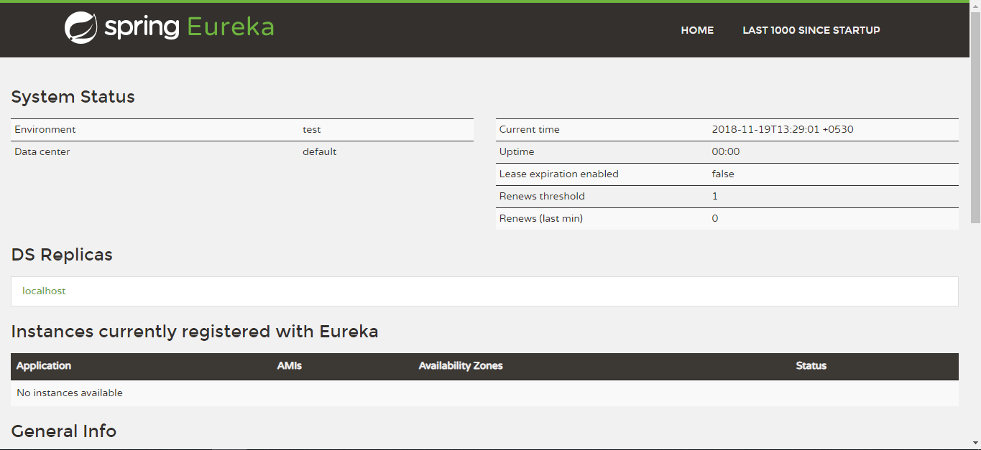
Step#1
Eureka Server (Port : 8761)
Dependecies: Eureka Server, Config Client, Actuator, Devtools
@EnableEurekaServer

Slide 28
Step#2
API Gateway (PORT: 8080 )
Dependecies: Zuul, Eureka Discovery, Actuator, Devtools
@EnableZuulProxy and @EnableDiscoveryClient

Slide 29
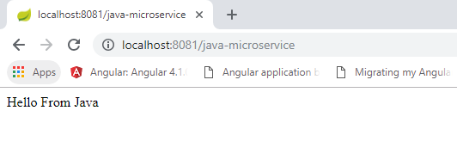
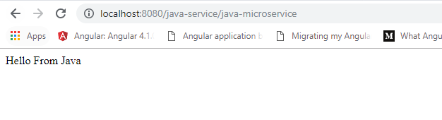
Step#3 : A service here and a service there.
Java - Microservice - Independent
Java- Microservice - Register With Eureka
Real Beauty Here:
You Add on Any Services, you don't need to restart Gateway neither Service Registry

Slide 30
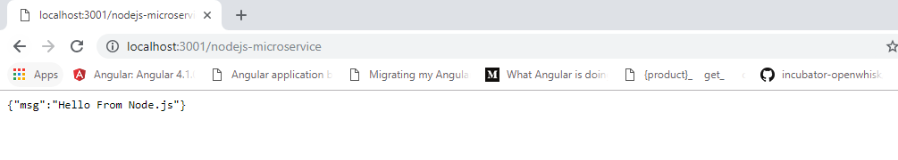
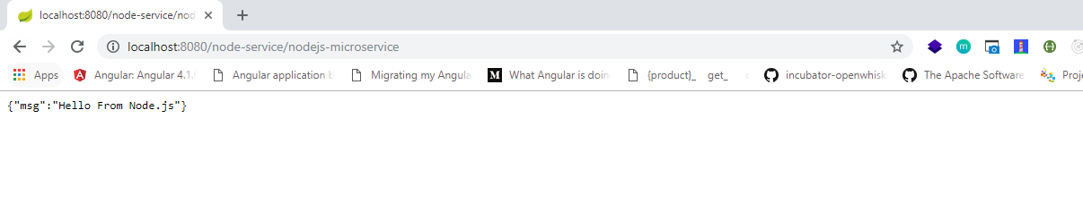
Step #4 : Different Services
Node Service -Independent
Node Service From Gateway

Slide 31
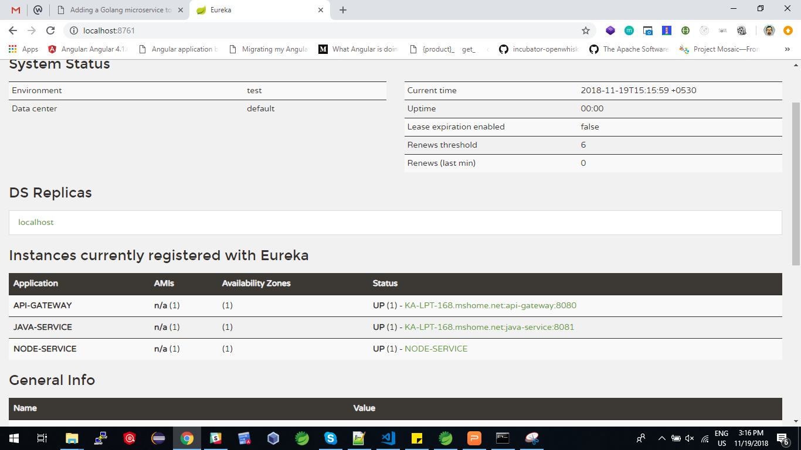

Slide 32
What NEXT ?
Is there something like this for FrontEnds ?
MicrofrontEnds (Will be presented on Ahmedabad JS)
Spring Cloud For Java Developers
Node JS Microservices
Practice Activity [Spring Cloud Development]

Slide 33
Questions?

Slide 34




KNOWARTH Technologies Pvt. Ltd.
INDIA: 11, Aryan Corporate Park, Nr. Shilaj Railway Crossing, Thaltej, Ahmedabad – 380059, Gujarat, INDIA USA: One Commerce Center, 1201 Orange Street #600,
Wilmington, DE – 19899
Email: parth.ghiya@knowarth.com | Website: www.knowarth.com

